Slide 1



CLIL LESSONS ON SCIENCE
AND PERSONAL DEVELOPMENT
Unit 1: REACHING FOR THE SKY
Unit 2: HEROES

Slide 2

The lessons further described are designed to teach students about role models, cultural heritage, science, personal development, inclusion and overcoming obstacles.
BRIEF DESCRIPTION OF THE LESSONS
“Be the change you want to see in this world.” – Gandhi

Slide 3
SCHOOL CONTEXT
The school is located in Timișoara, one of the biggest and most important cities in the West of Romania, but in a small neighbourhood towards the outskirts of the city. It is among the first ten schools in the Timiș county as far as learning results and National Evaluation marks are concerned. The students are 6 to 15 years old and most of them have had very good results in learning English, many of them participating in competitions and Cambridge examinations every year.

Slide 4
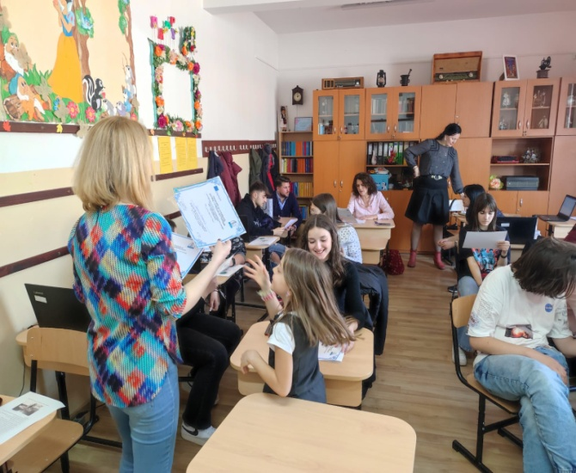
THINGS TAKEN INTO ACCOUNT
FOR LESSON PLANS AND UNIT PLANNING
●Learner’s needs: interests, age, background, language level
●Learning style - visual, auditory, kinesthetic
●Learner’s reflection and feedback
●Environment and context
●National curriculum
●Principle of integration and acceptance

Slide 5
• Class: Forth class of lower secondary school, 8th grade
• Age: 13/14
• Number of students: 25
• The class is made up of students with mixed abilities, some of whom lack motivation), others with excessive energy and very intelligent, one with special needs (CES).
Therefore, after a needs analysis through observation, reports, councelling, feed-back forms and open discussions showing the need to motivate, balance abilities in pair and team work, or provide ways to compensate difficulty, it is advisable to provide personalised learning plans to motivate more passive students or very energetic ones and implement a differentiation strategy for specific learning difficulties.
• Level of English: A2, A2+, B1, B1+
CLASS PROFILE

Slide 6
Global scale - Table 1 (CEFR 3.3):
Common Reference levels
ENDENT USER | B2 | Can understand the main ideas of complex text on both concrete and abstract topics, including technical discussions in his/her field of specialisation. Can interact with a degree of fluency and spontaneity that makes regular interaction with native speakers quite possible without strain for either party. Can produce clear, detailed text on a wide range of subjects and explain a viewpoint on a topical issue giving the advantages and disadvantages of various options.
 | B1 | Can understand the main points of clear standard input on familiar matters regularly encountered in work, school, leisure, etc. Can deal with most situations likely to arise whilst travelling in an area where the language is spoken. Can produce simple connected text on topics which are familiar or of personal interest. Can describe experiences and events, dreams, hopes & ambitions and briefly give reasons and explanations for opinions and plans.
BASIC USER | A2 | Can understand sentences and frequently used expressions related to areas of most immediate relevance (e.g. very basic personal and family information, shopping, local geography, employment). Can communicate in simple and routine tasks requiring a simple and direct exchange of information on familiar and routine matters. Can describe in simple terms aspects of his/her background, immediate environment and matters in areas of immediate need
 | A1 | Can understand and use familiar everyday expressions and very basic phrases aimed at the satisfaction of needs of a concrete type. Can introduce him/herself and others and can ask and answer questions about personal details such as where he/she lives, people he/she knows and things he/she has. Can interact in a simple way provided the other person talks slowly and clearly and is prepared to help.

Slide 7
Qualitative aspects of spoken language use –
Table 3 (CEFR 3.3): Common Reference levels
B2 | Has a sufficient range of language to be able to give clear descriptions, express viewpoints on most general topics, without much con­spicuous searching for words, using some complex sentence forms to do so. | Shows a relatively high degree of grammatical control. Does not make errors which cause misunderstanding, and can correct most of his/her mistakes. | Can produce stretches of language with a fairly even tempo; although he/she can be hesitant as he or she searches for patterns and expressions, there are few noticeably long pauses | Can initiate discourse, take his/her turn when appropriate and end conversation when he / she needs to, though he /she may not always do this elegantly. Can help the discussion along on familiar ground confirming comprehen­sion, inviting others in, etc | Can use a limited number of cohesive devices to link his/her utterances into clear, coherent discourse, though there may be some "jumpiness" in a long con­tribution.
B1 | Has enough language to get by, with sufficient vocabulary to express him/herself with some hesitation and circum-locutions on topics such as family, hobbies and interests, work, travel, and current events. | Uses reasonably accurately a repertoire of frequently used "routines" and patterns asso­ciated with more predictable situations. | Can keep going comprehensibly, even though pausing for grammatical and lexical planning and repair is very evident, especially in longer stretches of free production. | Can initiate, maintain and close simple face-to-face conversa­tion on topics that are familiar or of personal interest. Can repeat back part of what someone has said to confirm mutual understanding. | Can link a series of shorter, discrete simple elements into a connected, linear sequence of points.

Slide 8
Qualitative aspects of spoken language use –
Table 3 (CEFR 3.3): Common Reference levels
A2 | Uses basic sentence patterns with memorized phrases, groups of a few words and formulae in order to commu­nicate limited information in simple everyday situations. | Uses some simple structures correctly, but still systematically makes basic mistakes. | Can make him/herself understood in very short utterances, even though pauses, false starts and reformulation are very evident. | Can answer questions and respond to simple statements. Can indicate when he/she is following but is rarely able to understand enough to keep conversation going of his/her own accord. | Can link groups of words with simple connectors like "and, "but" and "because".
A1 | Has a very basic repertoire of words and simple phrases related to personal details and particular concrete situations. | Shows only limited control of a few simple grammatical structures and sentence patterns in a memorised repertoire. | Can manage very short, isolated, mainly pre-packaged utterances, with much pausing to search for expressions, to articulate less familiar words, and to repair communication. | Can ask and answer questions about personal details. Can interact in a simple way but communication is totally dependent on repetition, rephrasing and repair. | Can link words or groups of words with very basic linear connectors like "and" or "then".

Slide 9
PARTICIPANT
FEED-BACK
PROVIDER
TEACHER’S ROLE
FACILITATOR
MEDIATOR
TUTOR
ORGANISER
PROMPTER
OBSERVER
MOTIVATOR
ASSESSOR
RESOURCE

Slide 10
GENERAL AIMS OF THE UNIT
To develop bilingual and multicultural skills;
To use interpersonal skills;
To discover and use their own learning style;
To develop problem solving skills;
To develop effective communication skills;
To develop the ability to speak in front of an audience;
To develop the ability to express their point of view and give arguments.

Slide 11
KEY COMPETENCES FOR LIFELONG LEARNING
Literacy
Multilingualism
Mathematical, science, technology and engineering
Digital
Personal, social and learning to learn
Active citizenship
Entrepreneurship
Cultural awareness and expression

Slide 12

Unit 1: REACHING FOR THE SKY
L1 – DREAMS OF FLYING
L2 – LIVING THE DREAM
L3 – CHECK POINT
DESCRIPTION OF LESSON 1 “DREAMS OF FLYING”

Slide 13
SPECIFIC LEARNING OBJECTIVES
By the end of LESSON 1 of U1 (DREAMS OF FLYING) students will:
LINGUISTIC OBJECTIVES
CONTENT OBJECTIVES
●acquire new vocabulary on the topic of flying aircrafts and mechanics
●use past simple and past continuous in stories about famous inventors
●become aware of the importance of cultural heritage (CULTURAL AWARENESS)
●be able to select information on famous
inventors (ICT AND SUMMERISING SKILLS)
●be able to use technical information to
recreate their own prototype of Vuia 1 using recycled materials
(TECHNICAL AND ARTISTIC SKILLS)
●report information about inventors (written and oral production)
●open up to communication even if they would not normally interact with each other (CRITICAL THINKING AND PROBLEM-SOLVING)
●exchange ideas (oral production)

Slide 14
SKILLS AND MODES OF
COMMUNICATION INVOLVED
RECEPTION
(VIDEO AND READING)
PRODUCTION
(WRITING AND
SPEAKING)
INTERACTION (SPEAKING)

Slide 15
PREVIOUSLY
ACQUIRED KNOWLEDGE
LANGUAGE LEVEL:
Minium A2 Level – according to CEFR
TECHNOLOGY:
Can use INTERNET, QUIZZIZ PLATFORM, MICROSOFT OFFICE
Can build objects from recycled materials
CLASSROOM/ INTERDISCIPLINARY KNOWLEDGE:
Know past simple and basic elements of physics

Slide 16
TOOLS
HARDWARE
SOFTWARE
LAPTOPS/
SMARTPHONE
MICROSOFT
OFFICE
INTERNET ACCES
IQ-BOARD
GOOGLE PLATFORMS

Slide 17
UNDERLYING THEORY | CONSTRUCTIVISM
FRAMEWORK | ●TASK-BASED LEARNING (TBL)
APPROACH | ●LEARNER-CENTRED, COMMUNICATIVE
ACTIVITIES | ●TASK-BASED ●SELECTING INFORMATION ●FILL IN THE GAPS ●ANSWERING QUESTIONS ●CLASS DISCUSSION ●COOPERATIVE LEARNING
INTERACTION | ●INDIVIDUAL – GROUP WORK
TEACHING
METHODOLOGY

Slide 18
CURRICULUM CONNECTIONS
Technology
• Science
Crafts/
Art
Understanding basic principles of physics.
Students recreate their own prototype of Vuia 1 using recycled materials.
Use of INTERNET, GOOGLE PLATFORMS, QUIZZIZ PLATFORM, MICROSOFT OFFICE.
Becoming aware of the importance of history of science.

Slide 19
HUMAN
RESOURCES
TECHNOLOGY/SCIENCE
TEACHERS
LEARNING
SUPPORT TEACHERS
SOCIAL
SCIENCE/ FORM
TEACHERS
ENGLISH
TEACHERS

Slide 20
INCLUSION. WAYS TO INTEGRATE
AND SUPPORT SS WITH LEARNING CHALLENGES
  Learning difficulty
Hard to learn to speak English and understand written language
Differentiation Strategy
  Adapted curriculum for CES ( special needs) according to HG 7/18 from 27.02.2019
Student
with
CES
Ways to compensate difficulty
Personalized methods

Slide 21

PERSONALISATION STRATEGY
For students lacking motivation
Involve them as much as possible during the whole lesson
Ensure balanced abilities in each small group: two weaker students grouped with three more advanced
Promote peer tutoring and working together
Personalize the lesson to fit their interests
For students with a lot of energy
Involve them as much as possible during the whole lesson
Offering the role of leader in their group
Promote working together

Slide 22
DIFFERENTIATION STRATEGY
For students with specific learning difficulties (CES)
Ways to compensate difficulty
- extra time
- less work
- visual aids
-peer tutoring – group work
-simplified tests to account for learning difficulties
Personalized methods
-copying from the board
-notes taking
-spelling or agreement mistakes won`t be
considered

Slide 23
FORMATIVE ASSESSMENT
Because the lessons are part of a learning unit, formative assessment will take place during the lessons and will be based on involvement and performance of the students and their response to oral conversations, presentations, debates, small projects and discussions.

Slide 24
POSSIBLE PROBLEMS AND SOLUTIONS
Internet not working
Provide paper handouts, have an offline version that can be used from the T’s laptop, use phones
Energetic/Disruptive students
Keep them actively involved, assign responsibilities
Speaking anxiety
Extra support, encourage and guide them gradually towards production (written/ oral)
More dificult than expected
Prepare alternative, encourage and guide them gradually
If student finishes earlier
Prepare extra handouts and activities

Slide 25
Description of Procedure of Lesson1 U1
DREAMS OF FLYING
PHASE/ STAGE | TIME | INTER- ACTION | T ACTIVITY | SS ACTIVITY | AIDS | EVALUATION | INCLUSION
ENGAGE/ WARM-UP | 2 | T C | Greetings, T cheks attendance. | SS answer
INTRO | 5 | T C | T writes the title, then shows the student a picture of Icarus and asks them about the legend, as a dream becoming reality. | SS identify the legend and answer | Projector Laptop Internet | Observation | S is helped to identify the legend, writes 5 words in Romanian and translates them in English
TASK/ READING AND SUMMERY | 12 | S S | T groups Ss IN 5 groups, gives them cards with the name of an inventor and asks them to look up info. about them, then write about their findings in past simple (T gives an example and acts as facilitator). T explains new words related to flying. | SS work together, search and select the relevant info. SS write new words. | Laptop/ Phones Internet Notebooks | Observation Formative | S identifies and writes name, period, country in English. S writes new words from the board.
SPEAKING | 10 | Ss C | T asks students to report to another group info about period, country, flying aircraft and difficulty in discovery or invention, using past simple. (T supervises, gently corrects or clarifies meaning) T shows Ppt with the most important info | SS change places and report to another group | Board Notebooks | Observation | S reports the info with help from the T. S writes from the board.

Slide 26
PHASE/ STAGE | TIME | INTER- ACTION | T ACTIVITY | SS ACTIVITY | AIDS | EVALUATION | INCLUSION
POST-READING/ PRACTICE | 7 | T C S S | T reinforces and checks info about flying aircrafts and inventors, past simple and new vocabulary on the Quizziz platform (fill in the gaps). | SS answer | QUIZZIZ Laptop Internet | Frontal Observation | S is helped by colleagues
CONCLUSION | 8 | T C | T plays the video about Traian Vuia, created by SS and asks for the SS opinion about his determination and if they think we can learn something from his attitude in chasing his dream. | SS watch the video and answer. | Projector Laptop Internet | Observation | S is helped to identify the legend, writes 5 words in Romanian and translates them in English
HW FEEDBACK AND ASSESSMENT | 6 | S S | T asks SS to work in groups to make a model airplane similar to Vuia 1 from recycled materials. T gives SS handouts with feedback and self-assessment and asks them to complete them. | SS reflect on the lesson and write. | Board Notebooks | Observation | S completes feedback and assessment with help from the teacher.

Slide 27
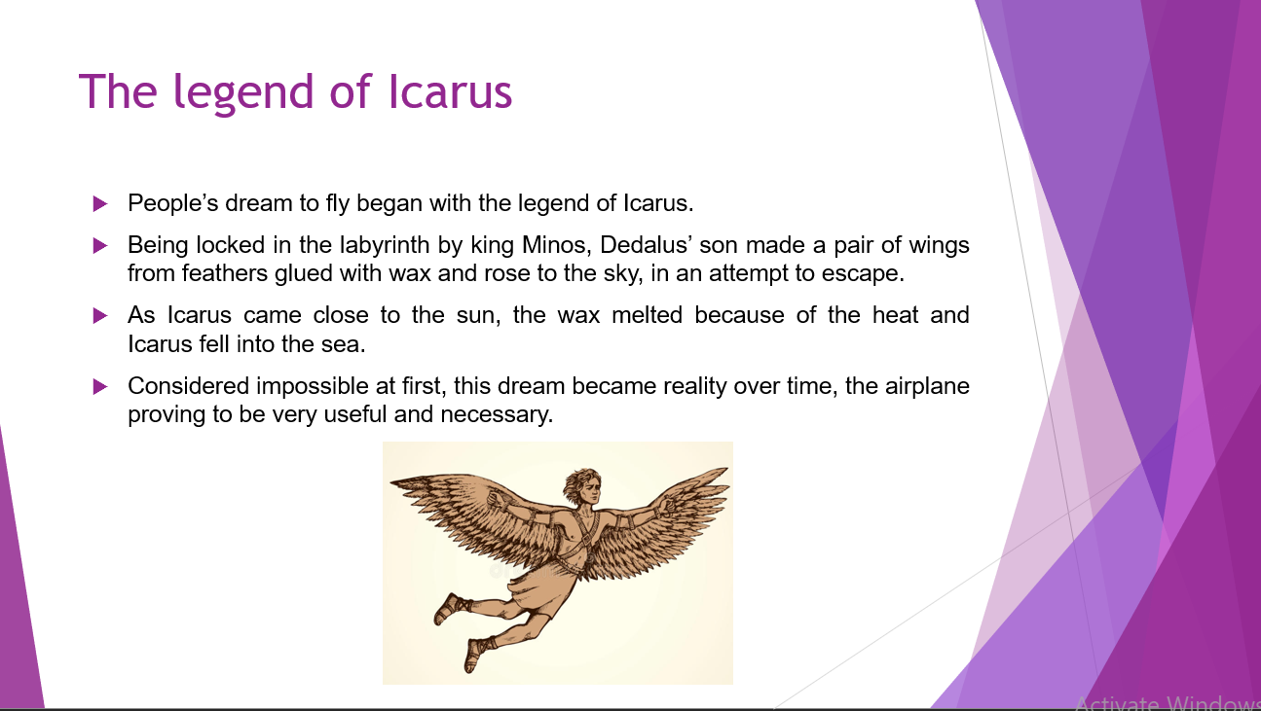
Examples of slides/ handouts

Slide 28
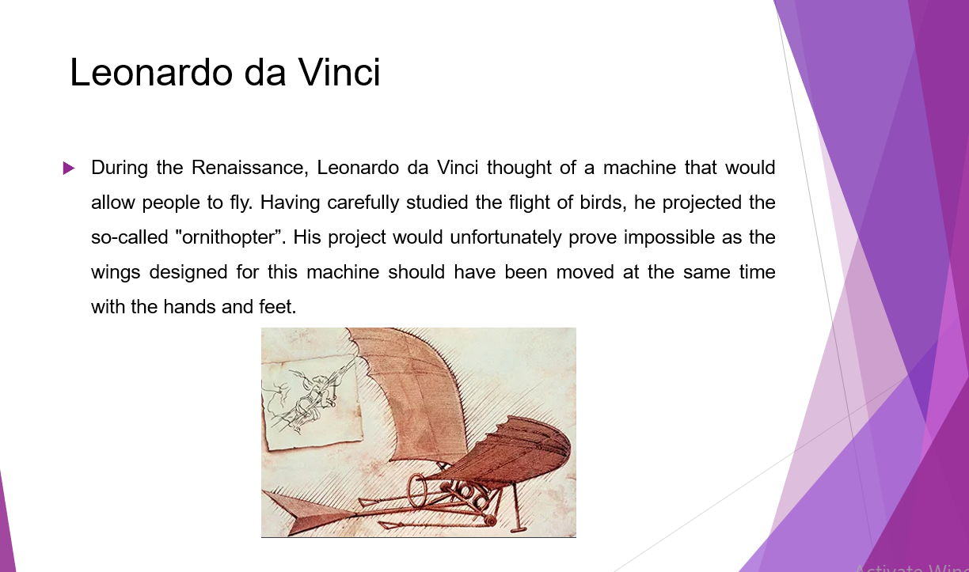

Slide 29
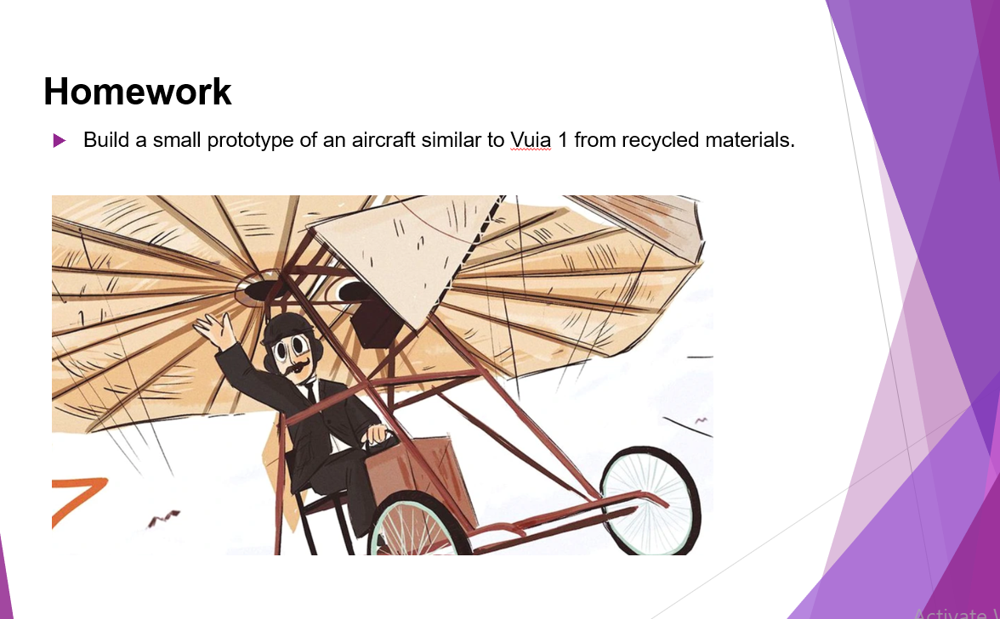

Slide 30
Lesson 2 U1 in brief – “Living the Dream”
No. | Stage | Activity | Skills | Interaction | Aids | Evaluation | Time
1. | Warm-up | Greetings, check attendance and hw | Speaking | T - Ss |  |  | 3’
2. | Project presentation | Ss present their work in front of the class, answer questions, give explanations | Speaking | S - Ss | Board Laptop Projector | Observation Formative | 15’
3. | Discovery stage | Ss discuss physics principles used by Traian Vuia and advantages of flying | Speaking | Ss - Ss T - Ss | Board Laptop Prototype | Observation Formative | 8’
4. | Theory | Ss write the definition and formula for speed | Writing | T - Ss | Board | Observation | 5’
5. | Practice | Ss calculate speed of planes and distance in different situations | Writing | Ss – Ss, P | Board Notebook | Observation Formative | 12’
6. | Wrap up | Hw, feedback, self-evaluation | Writing | T - Ss Ss - T | Handouts |  | 7’

Slide 31
Lesson 3 U1 in brief – Check Point
No. | Stage | Activity | Skills | Interaction | Aids | Time
1. | Warm-up | Greetings, check attendance | Speaking | T - Ss |  | 3’
2. | Explanations | Announcing the content of the test and giving guidelines, rules, explanations | Speaking | T - Ss | Board Handouts | 5’
3. | Testing | T supervises the Ss | Writing | Lockstep | Handouts | 40’
4. | Wrap up | Hw, feedback | Writing Speaking | T - Ss | Notebooks | 2’

Slide 32
CRITERIA FOR FORMATIVE ASSESSMENT
Social and cross-cultural skills | SCORE
Respects cultural difference
Open to different ideas
Team-work
Interacts effectively in a team towards negociation
Works well in a team (at ease and collaborative)
Communication
Communicates clearly and effectively in oral and written form

Slide 33
SELF - ASSESSEMENT
On a scale from 1 to 5 now I can
A) select information on a given subject
B) use new words when talking about flying aircrafts
C) talk about famous inventors in the past tense
D) communicate with my classmates more efficiently to exchange ideas and solve problems
E) be more confident about speaking in front of people
The easiest thing was …………………………..
The most difficult thing was …………………………….
In the future I am determined to ………………………………………….
LESSON ASSESSEMENT/ TEACHER FEEDBACK
What I liked the most was …………………….
I found it boring to …………………….
In the future I would like to ………………………………………….

Slide 34
GROUP WORK ASSESSEMENT
INDICATORS | RARELY | SOMETIMES | FREQUENTLY | USUALLY | ALWAYS
Interest and participation
Participates actively and contributes with ideas or research
Time and work load management
Can manage time and work properly and completes the task
Social and intercultural skills
Respects cultural differences and is open to different ideas

Slide 35

PROPOSAL FOR WRITING ASSESSEMENT
LEVEL | Excellent | Good | Medium | Basic | Below basic
CONTENT | Quality content, relevant to the task (eg: 28 - 30 p) | Generally relevant content | Content related to the task | Attempts content related to the task, may have missinterpretations | Content is irrelevant
ORGANISATION | Text is well organised and coherent, using a variety of linking words and cohesive devices and the ideas are logical and well connected (eg: 19 - 20 p) | Text is connected and coherent, using basic linking words and a limited number of cohesive devices (first of all, afterwards, moreover, in conclusion) | Ideas are connected using basic linkers correctly and there are paragraphs | Ideas are connected using basic linking words (and, but, so) and there is an attempt to organise them in paragraphs | Text is impossible to understand due to incoherence and lack of linking words and paragaphs
VOCABULARY | Uses wide range of lexis correctly (including uncommon and field specifics terms) and appropiate to the task or type of text (eg: 24 - 25 p) | Uses everyday vocabulary correctly and may try to use more uncommon and field specifics terms | Uses common vocabulary generally correctly and the message is clear | Uses common and basic vocabulary and may have mistakes, but the message is understood | Vocabulary confusions and words from native language that impede the meaning of the message
GRAMMAR | Uses complex grammar forms correctly and appropiate to the task or type of text (eg: 14 - 15 p) Total: 95-100 p maximum (equivalent of a 10 in the Romanian system of education) | Uses simple grammar forms correctly, attempts complex structures Total: 85-94 p maximum (equivalent of a 9) Obs: An 8 would be between categories Good and Medium, 75 p-89 p. | Uses simple grammar forms correctly,and the message is clear Total: 74 p maximum (equivalent of a 7) | Uses simple grammar forms and may have mistakes, but the message is understood Total: 54 p max. (equivalent of a 5 - passing) | Grammar errors that make it diificult for the reader to understand the message Total: 34 p max. (equivalent of a 3 – not passing)
INDICATORS
CRITERIA DESCRIPTORS
10 p
granted

Slide 36
PROPOSAL FOR SPEAKING ASSESSMENT
Level | Excellent 10 | Good 9 | Medium 7 | Basic 5 | Below basic 3
Presentation skills | Uses a clear voice, captures, maintains the attention of the audience and interracts with them | Generally clear voice, captures and maintains the atention of the audience | Attempts to capture and maintain the attention of the audience, the pace is too slow or too fast | Speaks too quietly for the majority of students, attempts to get the attention of the audience | Is unable to speak in front an audience without help
Language (grammar and vocabulary) | Language is precise and appropriate for the context, very good use of filler words. | Uses common vocabulary, expressions linking words and simple grammar structures correctely | Recognises and uses common vocabulary, expressions and simple grammar structures generally correctly | Basic vocabulary and simple grammar, with mistakes that do not impede communication | Words from native language and grammar errors impede the meaning of the message
Interaction skills | Initiates, maintains and concludes conversation and gives details on a given topic easily | Initiates, maintains and concludes simple conversation on a given topic generaly without effort | Initiates and tries to maintain a simple conversation on a given topic with some effort | Attempts to initiate and maintain simple conversations on a given topic generally with mistakes | Does not initiate conversation, has trouble responding to questions
Organisation | Information is presented in a logical way which audience or interlocutor can follow easily | Information is presented in logical sequence which audience can generally follow | Ideas are connected despide some errors | Attempt to connect ideas and use simple linking words | Speech is impossible to understand due to incoherence
Obs: In the Romanian system of education the first passing mark is 5. Marks 8, 6 and 4 in between these categories would take into account features from both categories of descriptors. Ss can be granted different marks (for instance: 7 in interaction, 7 in organization, 6 in presentation and 5 in language.) |  |  |  |  | Final Score:

Slide 37
Bibliography:
Delaney, D., Ward, C. &amp; Carla Rho Fiorina. 2003, Fields of Vision. Literature in the English Language. Longman
Evans, V., 2002, Successful Writing, Express Publishing
Harmer, J. 2001, The Practice of English Language Teaching. Pearson Education Limited
Ovid, The Fall of Icarus, 2015, Taken from Books VIII and IX of Mary M. Innes’s translation of Metamorphoses, Penguin Books
Pârlog, H., 1982, The English Verb, Timişoara: TUT
Scrivener, J., 2008, Learning Teaching, Macmillan
https://www.coe.int/en/web/common-european-framework-reference-languages/level-descriptions
https://www.youtube.com/watch?v=4CPD8-_i1kc
https://jurnalul.ro/calendar/traian-vuia-de-la-zmeie-de-hartie-la-aeroplane-621307.html
https://acad.ro/academica2002/rev2016/pag_acad2016_nr308_iun.pdf#page=37
https://www.cambridge.org/core/journals/aeronautical-journal/article/abs/traian-vuiaa-littleknown-pioneer/F2093BF1D14BE5FEEFD571F41759CD8B
https://www.youtube.com/watch?v=i9YcYEhqYbc&t=83s

Slide 38
ROMANIAN LAW REFERENCES
Legea educaţiei naţionale nr. 1/2011
http://programe.ise.ro/Portals/1/Curriculum/2017-progr/19-Limba%20moderna1.pdf
https://www.ise.ro/wp-content/uploads/2015/12/Profilul-de-formare-al-absolventului_final.pdf
https://moodle.usm.md/pluginfile.php/197167/mod_resource/content/1/limba_straina_curriculum_gimnaziu.pdf
https://www.ucv.ro/pdf/invatamant/educatie/grade_didactice/ENGLEZA-GRD.II.pdf
https://www.edu.ro/sites/default/files/fisiere%20articole/Strategie%20LLL.pdf
https://www.edu.ro/sites/default/files/_fi%C8%99iere/Invatamant-Preuniversitar/2016/special/ORDIN%205574_2011_Ordin_si_Metodologie_servicii_sprijin_educa%C5%A3ional_tinerii_CES_integra%C8%9Bi_%C3%AEn_%C3%AEnv_de_mas%C4%83.pdf
https://www.edu.ro/sites/default/files/_fi%C8%99iere/Minister/2021/inv.preuniversitar/repere%20curriculum%20clasa%20a%20IX-a%202021%20-%202022/special/06_Engleza_IPS_Repere%20%20metodologice_cls_9.pdf

Slide 39
Don’t forget to have fun teaching these lessons ☺
THANK YOU!
Teachers: Delia Marincu, Mirabela Rusu-Vatris, Maria Todor

